Slide 1
Interquartile Range - Outlier Detection

Slide 2
IQR
The Interquartile Range, or IQR, is a measure of statistical dispersion. It represents the range within which the middle 50% of the data falls. To calculate the IQR, you need to find the difference between the 75th percentile (Q3) and the 25th percentile (Q1).
IQR = Q3 — Q1
To identify outliers using the IQR method, we establish two boundaries:
Lower Bound: Q1–1.5 * IQR
Upper Bound: Q3 + 1.5 * IQR

Slide 3
IQR Cont.
Any data point that falls below the lower bound (Q1–1.5 * IQR) is considered an outlier.
Conversely, any data point that exceeds the upper bound (Q3 + 1.5 * IQR) is also considered an outlier.
Effective in skewed data.
Easy to implement and interpret.

Slide 4
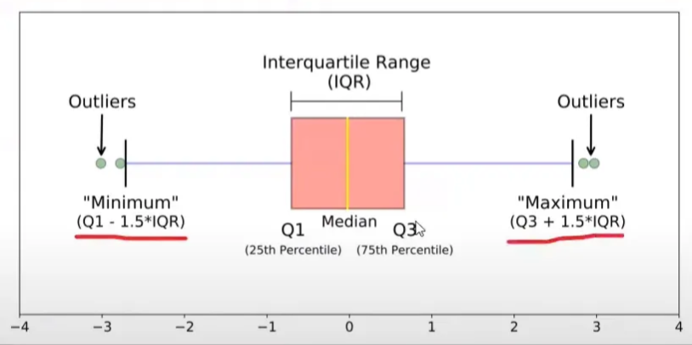
IQR Cont.

Slide 5
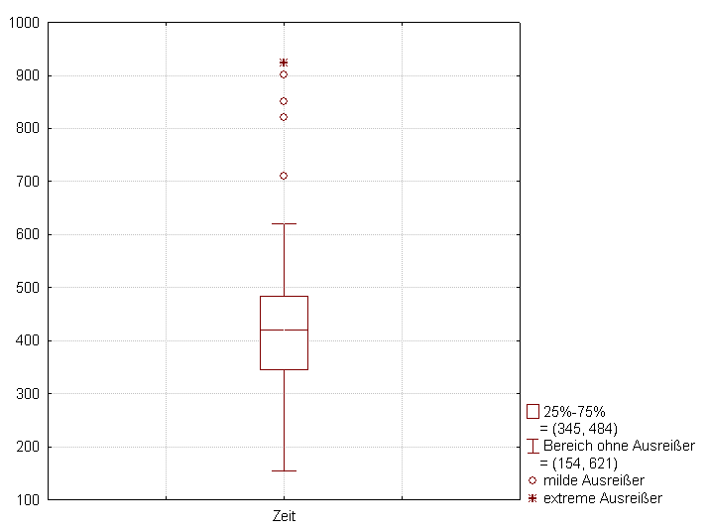
Box Plot

